Slide 1
Notes
This presentation is for workshop ‘Protect your IoT Fleet’
Latest update: March 2020 by phamh@

Slide 2
Resources/ References
CIS Controls Internet of Things Companion Guide V7.1
AWS IoT Security document
Ten security golden rules for IoT Solutions

Slide 3
Protect your IoT fleet
Presenter
Date

Slide 4












IoT abuse in the news
2014 - Spam emails
2015 – Hacked cars
2016 – Mirai botnet
2017 – Hacked cardiac devices
2018 – DoS and Cryptomining

Slide 5





IoT abuse scenerios
Denial of Service
Lateral threat escalation
Information theft
Surveillance
Sabotage attacks
Cryptocurrency mining
Ransomware
Malicious access point
Cloud infra abuse
Notes:
Denial of service - an attack that uses iot devices to prevent legitimate access to web services
Lateral threat escalation - Leveraging insecure IoT devices in order to bypass perimeter security for other IT resources
Surveillance and Information theft - theft of sensitive information such as still images from a connected camera
Ransomware and Sabotage attack - Device is forced to malfunction
Malicious access point - Device thinks it is communication with a legitimate web service but it is isnt.
Cloud infra abuse - Billing abuse causing financial loss to the company

Slide 6
Why should I care?
IoT data is sensitive
Security is not a commodity
Protect your business
And also, regulation is coming
Notes:
Expense of not having a solution
Sensitive – proprietary privileged and confidential
Security is a differentiator
IoT is happening => Security cannot be an after thought
IoT data is sensitive => Protect your business reputation
Security is not a commodity => one size does not fit all

Slide 7
What should be included in Security Solutions?
Prevent
Detect
Respond
Best practices
Notes:
In this workshop we will focus on Detect and Respond

Slide 8
In this workshop: Implement solutions to protect IoT devices
Module 1: Environment build
Module 2: Audit devices configuration
Module 3: Detect and response to a compromised device
Module 4: Receive alerts in real-time (extra-credit)
Github link to the workshop here

Slide 9




Module 1: Environment Setup
A pre-provisioned IoT device
A temporary AWS account
A configured IoT Thing that sends data to AWS IoT Core
An AWS Identity and Access Management (IAM) user

Slide 10


Definitions
IoT device – The physical IoT device out on the world
AWS IoT thing – A representation of a specific device or logical entity
Physical device or sensor
Logical entity like an instance of an application
AWS IoT topic– A JSON document used to store and retrieve current state information
Get and set the state of a device, regardless of immediate connectivity

Slide 11
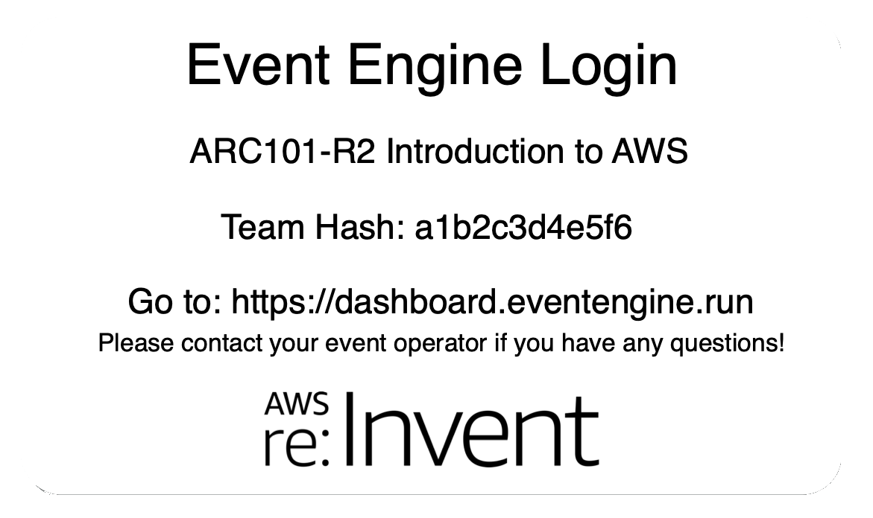
AWS Event Engine
https://dashboard.eventengine.run
The AWS Event Engine was created to help AWS field teams run Workshops, GameDays, Bootcamps, Immersion Days, and other events that require hands-on access to AWS accounts.
Notes:
Go to this URL in your browser

Slide 12
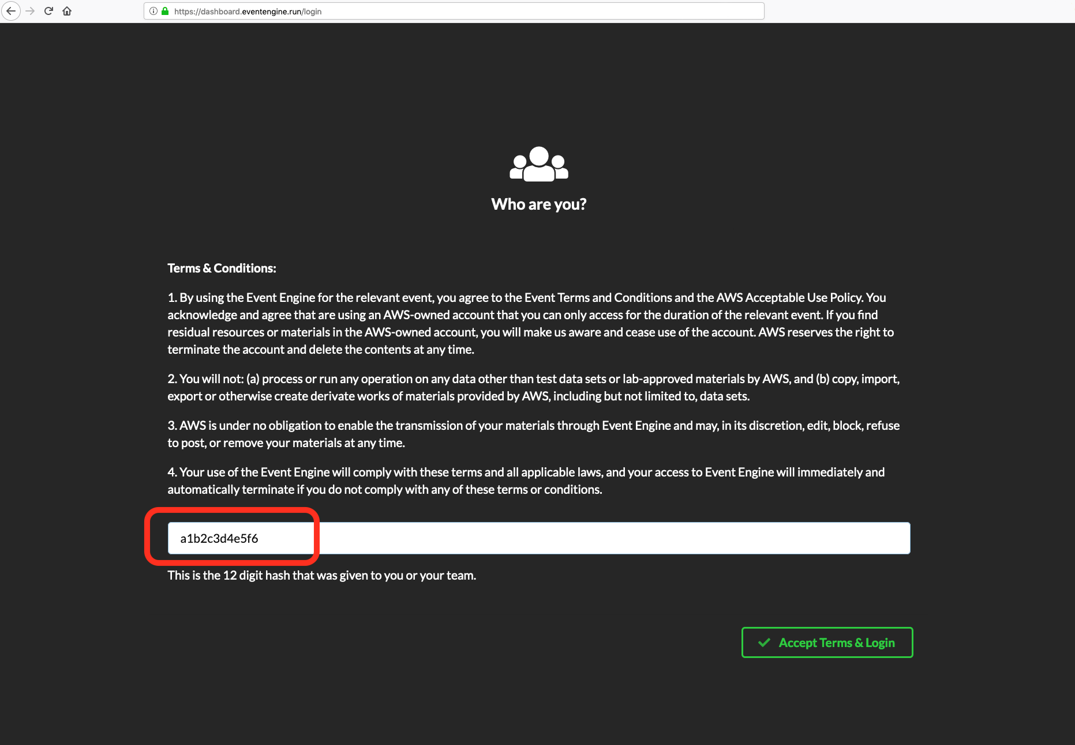
https://dashboard.eventengine.run
Notes:
You should be given a 12-character “hash” – this might be individual to you, or your team or group may share one hash.

Slide 13
What should be included in Security Solutions?
Prevent
Detect
Respond
Best practices
Notes:
In this workshop we will focus on Detect and Respond

Slide 14
Use a Single Identity and Credential Per Device

Slide 15
Apply authentication and access control

Slide 16
Deploy security auditing and monitoring mechanisms

Slide 17
Module 2: Audit your IoT Fleet
Github link here

Slide 18


AWS IoT Device Defender
Audit
Alert
Investigate
Mitigate

Slide 19
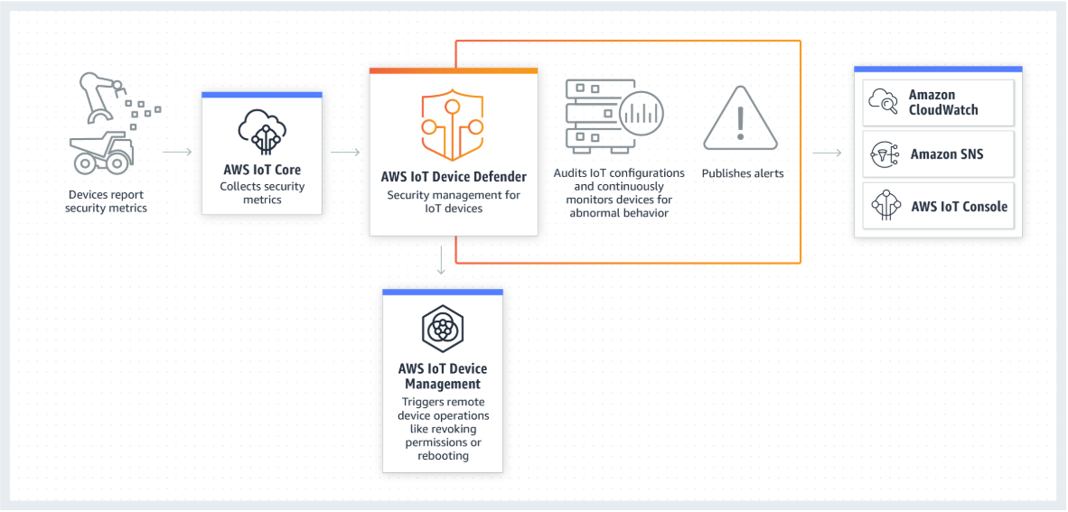
Architectural overview

Slide 20




Audit
Expiring or revoked certificates
Overly permissive policies
Device connection checks
Logging

Slide 21
What should be included in Security Solutions?
Prevent
Detect
Respond
Best practices
Notes:
In this workshop we will focus on Detect and Respond

Slide 22
Anomaly Detection - Denial of Service
1001
+
+
+
Packets out
Number of Ports and/or
Suspicious port communication
Communication with suspicious IP addresses
Bytes out
Notes:
Communication with victim IP address or suspicious command and control destinations

Slide 23
Anomaly Detection – Cloud infrastructure abuse
+
+
Message rate
Message size
Communication from suspicious Source IPs

Slide 24
Module 3: Detect and response to a compromised device
Github link

Slide 25
AWS IoT Device Defender
Detect
Alert
Investigate
Mitigate

Slide 26



Security profile
1001
Packets
Bytes
Message rate
Message size
IP Destination
Source IP
Connection metrics
Authorization failures
TCP Connections
Ports
Security profile
Device-side metrics
Cloud-side metrics

Slide 27
Module 4: Receive alerts in real-time
Github link here

Slide 28
Q&A

Slide 29
Thank you

